Slide 1

Data Analysis on mySQL Workbench
Pizza Sales Case Study
| Nishtha Goel |

Slide 2
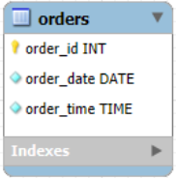
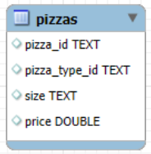
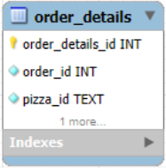
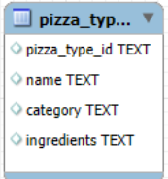
1
TABLES

Slide 3
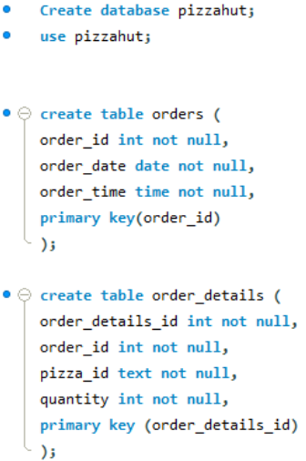
2
TABLE CREATION
&
DATA IMPORT

Slide 4
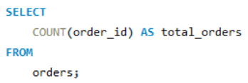

3
1. Retrieve the total number of orders placed
Query :
Query Results :

Slide 5
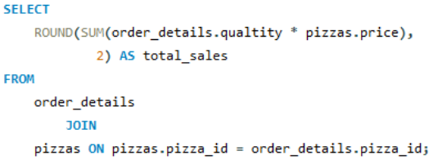

4
2. Calculate the total revenue generated from pizza sales
Query :
Query Results :

Slide 6
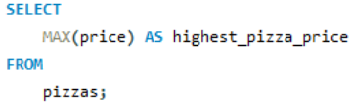

5
3. Identify the highest-priced pizza
Query :
Query Results :

Slide 7
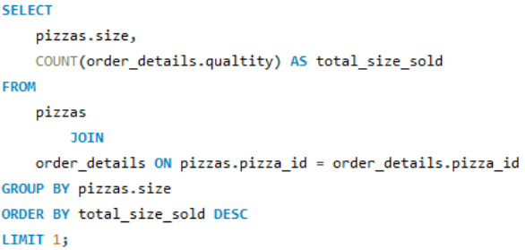

6
4. Identify the most common pizza size ordered
Query :
Query Results :

Slide 8
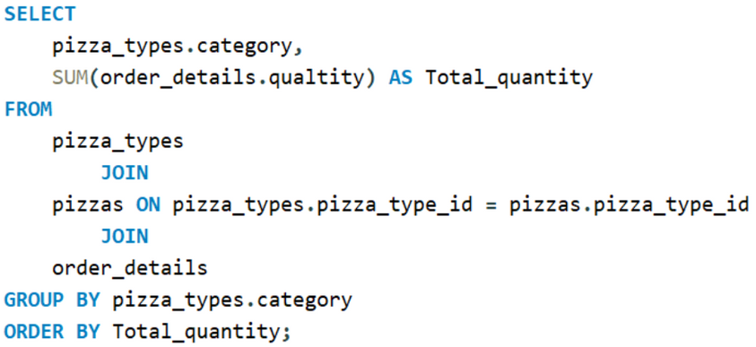
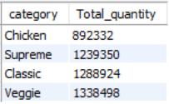
7
5. List the top 5 most ordered pizza types along with their quantities
Query :
Query Results :

Slide 9
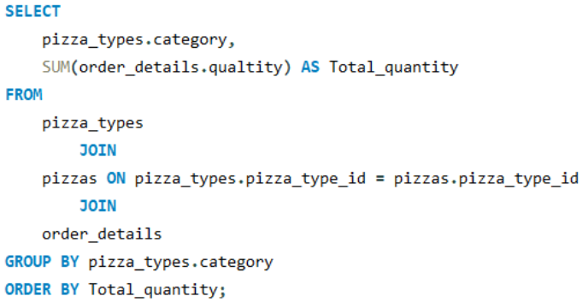
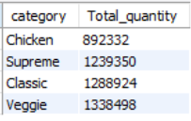
8
6. Join the necessary tables to find the total quantity of each pizza category ordered
Query :
Query Results :

Slide 10
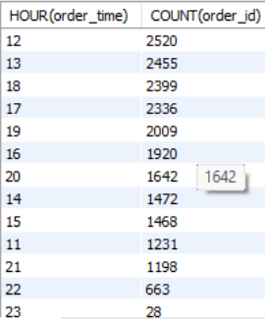
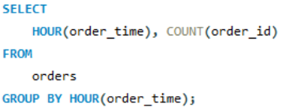
9
7. Determine the distribution of orders by hour of the day
Query :
Query Results :

Slide 11
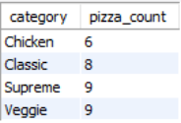
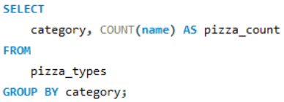
10
8. Join relevant tables to find the category-wise distribution of pizzas
Query :
Query Results :

Slide 12
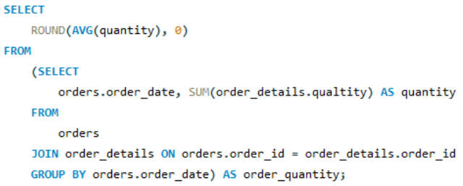

11
9. Group the orders by date and calculate the average number of pizzas ordered per day
Query :
Query Results :

Slide 13
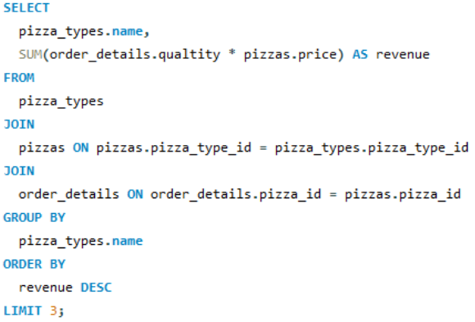
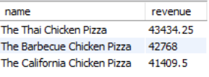
12
10. Determine the top 3 most ordered pizza types based on revenue
Query :
Query Results :

Slide 14
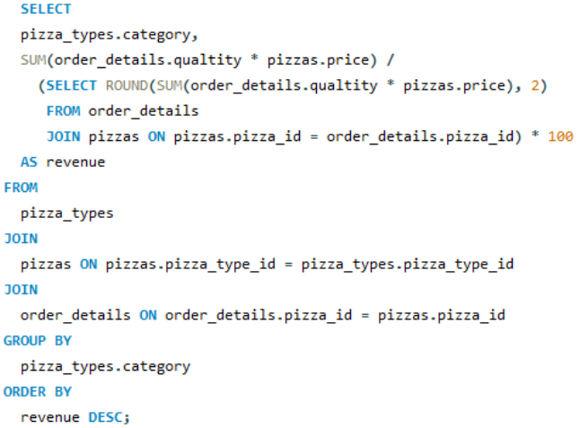
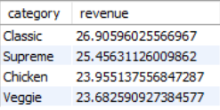
13
11. Calculate the percentage contribution of each pizza type to total revenue
Query :
Query Results :

Slide 15
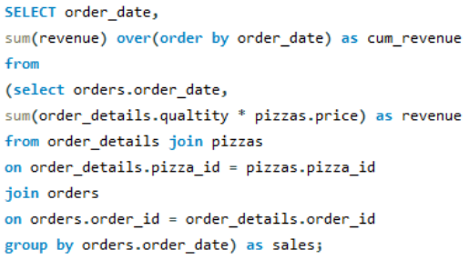
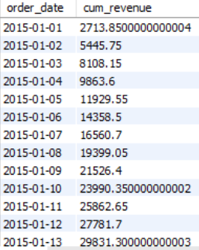
14
12. Analyze the cumulative revenue generated over time
Query :
Query Results :

Slide 16
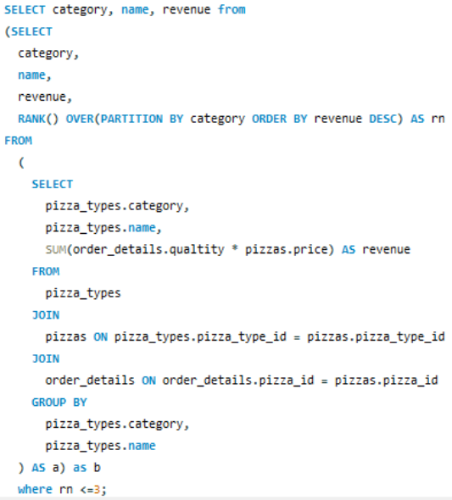
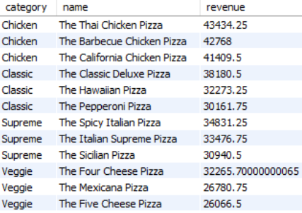
15
Query :
13. Determine the top 3 most ordered pizza types based on revenue for each pizza category
Query Results :

Slide 17
16
TOP 3 INSIGHTS
1
Average 138 pizzas ordered per day; aim to increase this number through targeted promotions.
2
Thai Chicken, Barbecue Chicken, and California Chicken pizzas drive revenue; consider upselling and cross-selling strategies.
3
Focus on Supreme pizzas (25.46% of total revenue) and Veggie pizzas (23.68%) to boost sales.

Slide 18
THANK YOU

